Slide 1

DECISION THEORY
By Group 3:
20pw01, 20pw19, 20pw24

Slide 2
Question
The sporting authorities of ADESA University are considering setting up an antidoping
test programme for university interschool athletes. Nevertheless, one of
the Sports Committee members and a Quantitative Methods teacher have some
doubts as to the use of such tests with student athletes given the possible social
costs incurred by a false-positive test. The teacher has decided to conduct a
mathematical study of the test process by taking into account the costs and reliability
of such tests, and the costs relating to negative and positive errors.
If the antidoping test programme is set up, student athletes will be expected to
do an antidoping test. The test result may be positive (suggests a potential user of
performance-enhancing drugs) or negative (does not suggest a potential user of
performance-enhancing drugs). If the test result is negative, no follow-up action
will be taken; yet if the test is positive, follow-up action will be taken to determine
whether the athlete or student actually uses performance-enhancing drugs.

Slide 3
Question
The difficulty in this decision model lies in assigning costs to several possibilities.
The teacher proposes employing the following potential costs:
Cost of a test with a false-positive result, C1.
Cost of a user of performance-enhancing drugs who has not been identified, C2.
Cost of someone innocent who has to do the doping test and it proves negative, C3.
Costs of properly identifying a user of performance-enhancing drugs, and the cost of an innocent athlete not doing the test is considered 0.
Draw the corresponding decision tree and indicate with a letter per
branch the associated probability or the associated cost (depending on the case

Slide 4
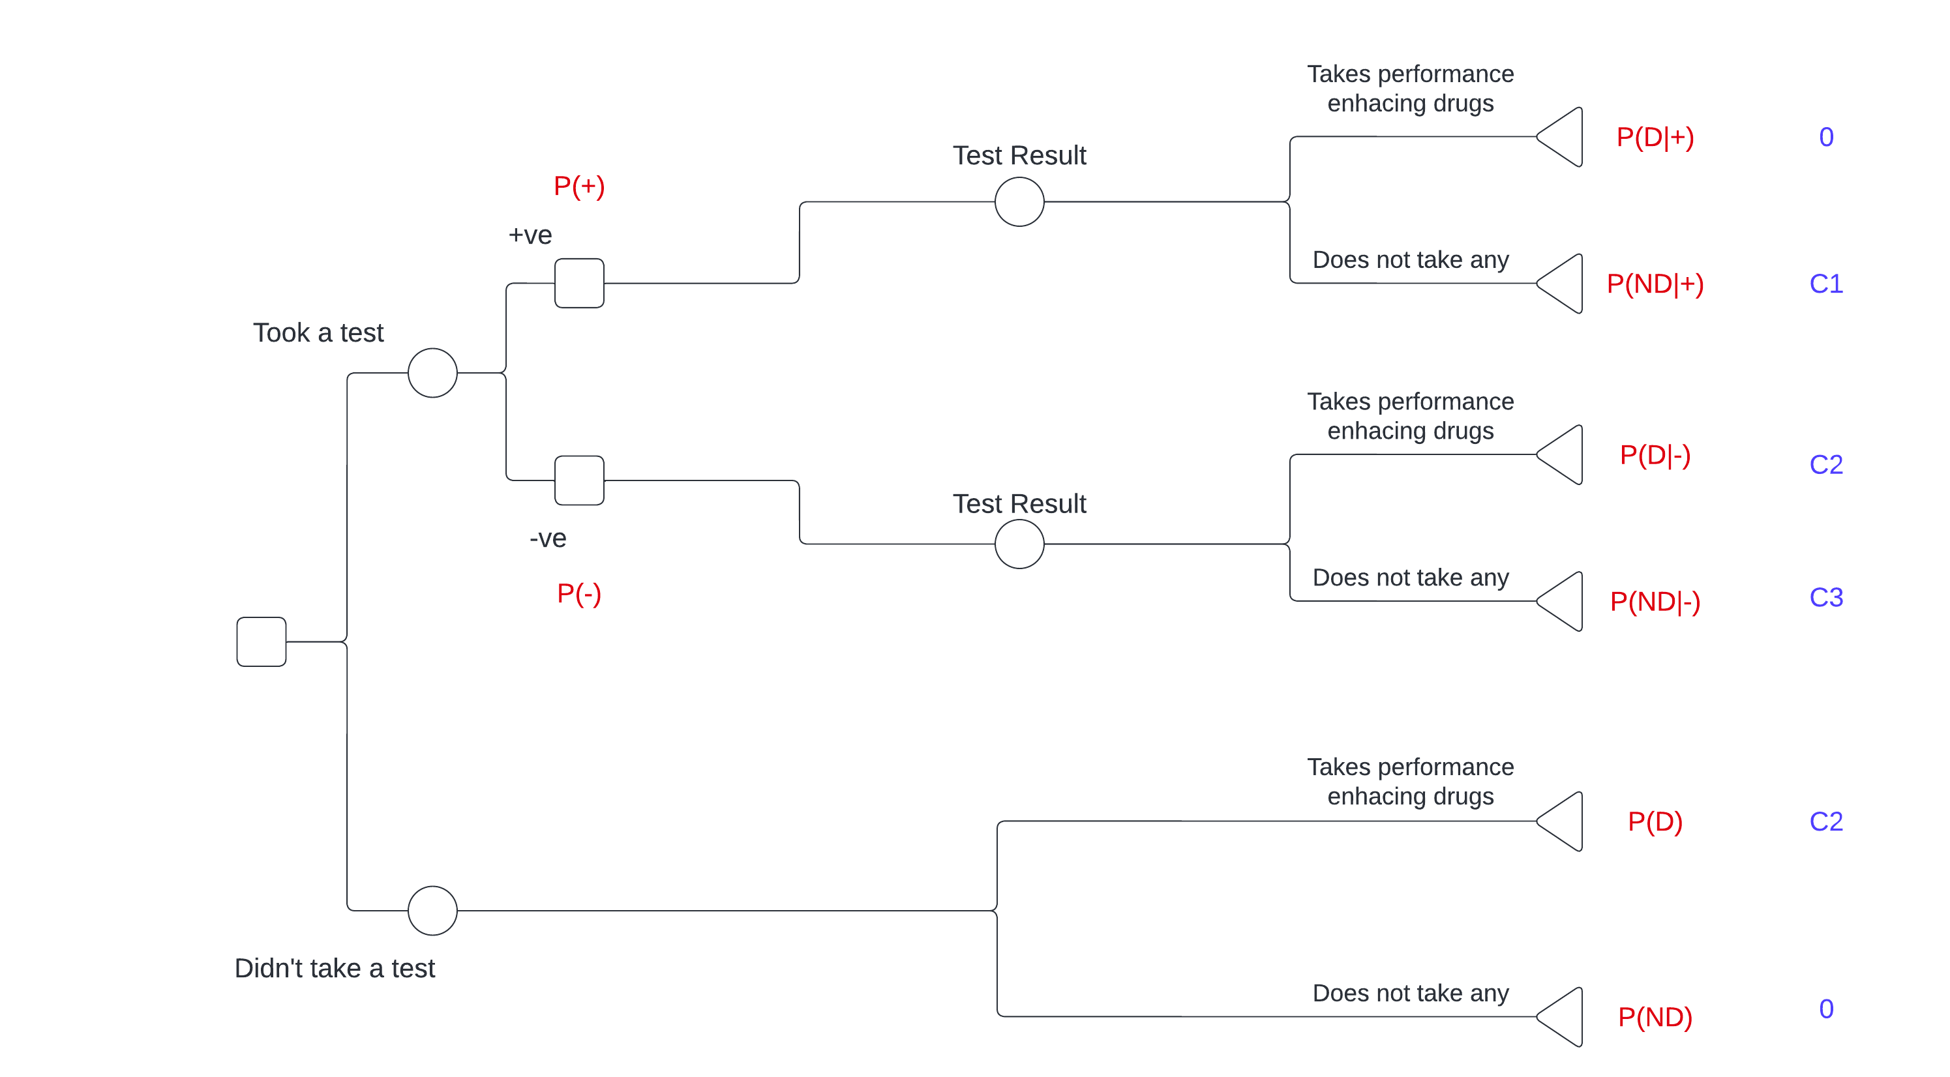

Slide 5
Question
No quantitative values have been assigned to C1, C2 and C3, but a hierarchy of
values have been established. In relative terms, C1 is the highest cost and C2 is
higher than C3. So: C1 >= C2 >= C3.
By assuming that test reliability is 95 % and that 5 % of athletes use
performance- enhancing drugs, considering the ADESA University Sporting
Committee’s objective of minimizing expected costs helps the teacher solve
the decision model.
Solve the tree and obtain the most economic solution.

Slide 6
(b) Solve the tree and obtain the most economic solution.
P(D) = 0.05
probability of an athlete having used performance-enhancing drugs
P(ND) = 0.95
Probability of an athlete not having used performance-enhancing drugs

Slide 7
The reliability data of imperfect information are:
P(+|D) = 0.95 (probability of the test being correct and reflecting the true
situation)
P(+|ND) = 0.05 (probability of the test being wrong and not reflecting the true
situation)
P(-|D) = 0.05 (probability of the test being wrong and not reflecting the true
situation)
P(-|ND) = 0.95 (probability of the test being correct and reflecting the true
situation).

Slide 8
P(+) = P(D)*P(+|D) + P(ND) *P(+|ND) = 0.095 (probability of the test being positive)
P(-) = P(ND) *P(-|ND) +P(D) *P(-|D) = 1 - P(+) = 0.905 (probability of
the test being negative)

Slide 9
By applying Bayes Theorem, the revised (a posteriori) probabilities are:
P(D|+) = P(+|D)*P(D)/P(+) = 0.5
P(ND|+) = P(+|ND)*P(ND)/P(+) = 0.5
P(D|-) = P(-|D)*P(D)/P(-) = 0.9972
P(ND|-) = P(-|ND)*P(ND)/P(-) = 0.0028

Slide 10
Cost of not doing test = 0.05 *C2 + 0.95 *0 = 0.05 *C2
Cost of doing test = 0.095 *(0.5 *0 + 0.5 *C1) + 0.905 *(0.0028*C2 + 0.9972*C3)
= 0.0475*C1 + 0.002534*C2 + 0.902466*C3
Cost of doing test–cost of not doing test
= 0.0475*C1 + 0.002534*C2 + 0.902466*C3 - 0.05*C2
The solution is to not set up the doping test programme.

